Slide 1
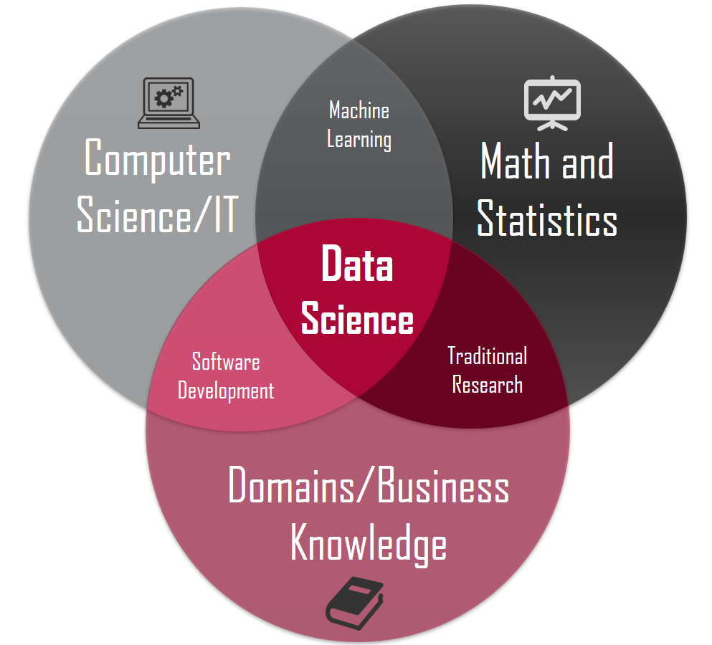

Data Science for House Hunting
By Juan Villegas

Slide 2
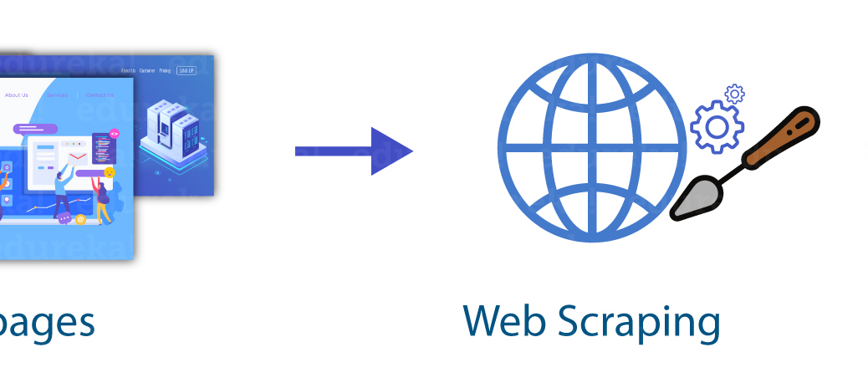
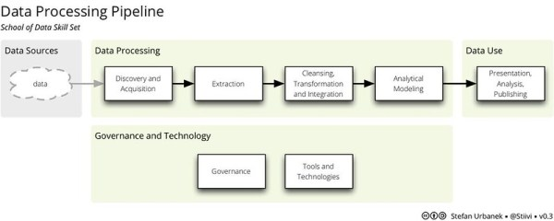
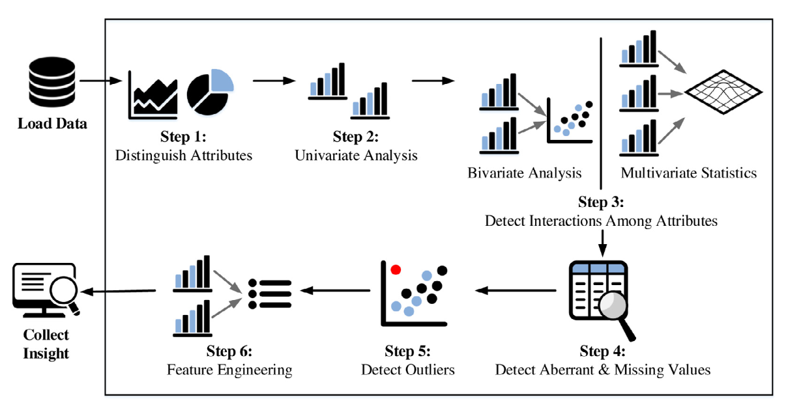
Concepts
Data Science: Using statistics, programming, and domain expertise to extract insights from data.
Web Scraping: the process of automating data extraction from websites.
Beautiful Soup: a Python library used for web scraping.
SQL & NoSQL: SQL is a relational database management system with MySQL being a popular DB
NoSQL: NoSQL is a non-relational database management system. MongoDB is a popular NoSQL DB
Exploratory Data Analysis (EDA): The process of analyzing and summarizing a dataset to gain insights and understanding.
matplotlib, pandas, and NumPy: Python libraries used for data analysis and visualization.
Regression & Classification: Supervised Machine learning algorithms used to classify & make predictions.
Data Pipelines: A series of automated steps for processing data

Slide 3

Overall objective
The overall objective of the project is to use data science techniques to help decide when buying a house. The project will focus on learning how to web scrape from Zillow's website to gather information on homes within a 15-mile radius of my job. The project will also involve creating two databases to store the information, conducting Exploratory Data Analysis, creating data science models, and automating the process using pipelines.
This project will prepare me for my summer internship.

Slide 4
Timeline:
February 22nd: Learn how to web scrape using Beautiful Soup in Python.
March 8th: Create SQL and NoSQL databases to store the information from Zillow's website.
March 29th: Conduct Exploratory Data Analysis of the variables gathered.
April 12th: Create data science models for regression and classification.
April 26th: Automate the process by creating pipelines.

Slide 5
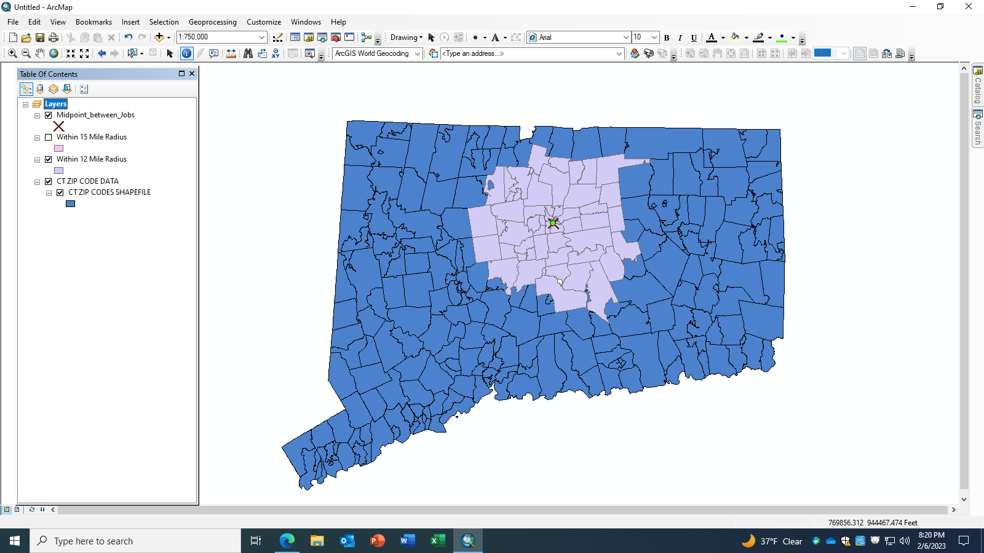
February 22nd: Web Scraping
Gather information on homes within a 15-mile radius of my job using Zillow’s website:
Using ARCMAP, create a spatial query that gives me a table of all the zips code (better precision) of all cities/towns within a 15-mile radius of my job.
Learn how to web scrape using the Beautiful Soup library in Python:
Decide what attributes I will be extracting from each house: Price, Year Built, # of bed/bath rooms, sqr footage, etc.…

Slide 6


March 8th: Database Creation
Store all the same information gathered into 2 databases (The 2 databases ties along with my Senior Research Project):
Design efficient and well put DB:
NoSQL DB → MongoDB
SQL DB →MYSQL
Query & Test database

Slide 7

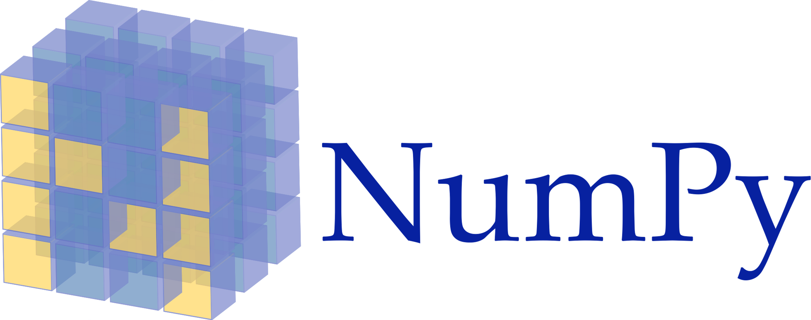

March 29th: Exploratory Data Analysis (EDA)
This Photo by Unknown Author is licensed under CC BY-SA-NC
Conduct an Exploratory Data Analysis of the variables gathered, using Python libraries such as matplotlib, pandas, or NumPy:
Simple Analysis:
Count plots/Histograms for each variable
Variable with an overlay of target variable ($250,000 price Limit)
For Numeric variables:
Each Variable vs Target Variable ($250,000 price limit) → Scatterplot
For Categorical Variables: This & This
Count plots , Frequency Distribution, etc…
Correlation Plots
This Photo by Unknown Author is licensed under CC BY-SA

Slide 8
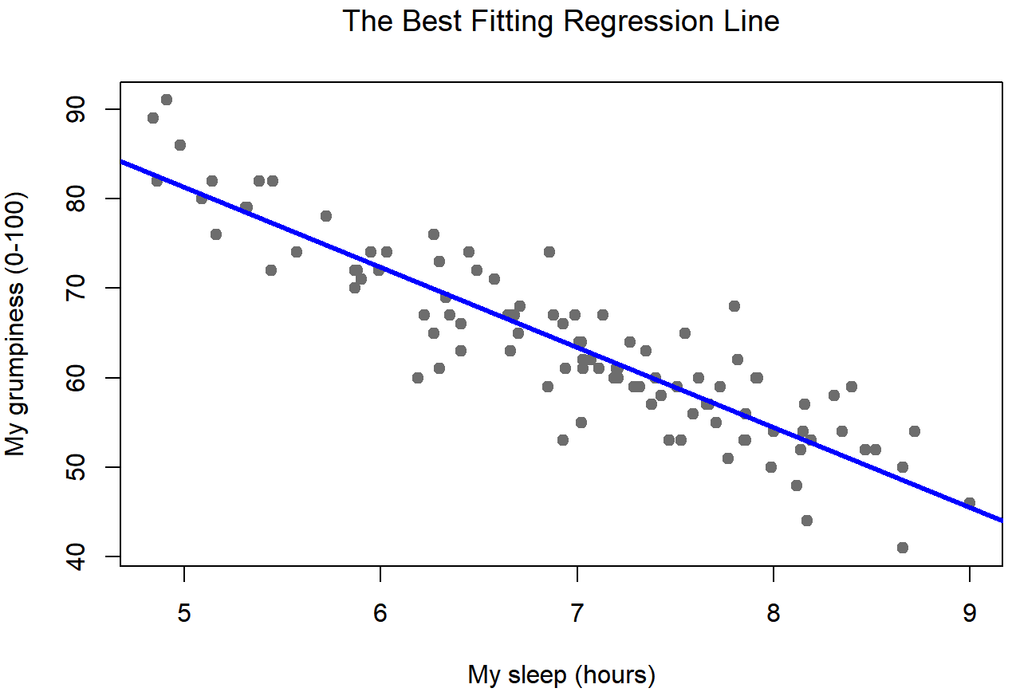
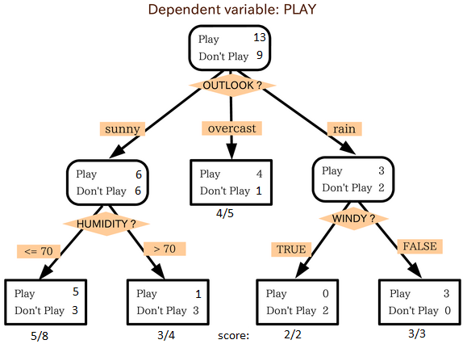
April 12th: Supervised Learning Data Science Models (Predictive & Classification)
Regression Models: Use this type of model to input the attributes I would want in a house to give me a predicted price.
Regression
Random Forest Regressor
Gradient Boosting Regressor
Classification Models: Use this model to see, given the specific data I have, where should I focus my attention with a price cap of $250,000
Cart Models
Naïve Bayes Classifier
Some sort of decision trees

Slide 9
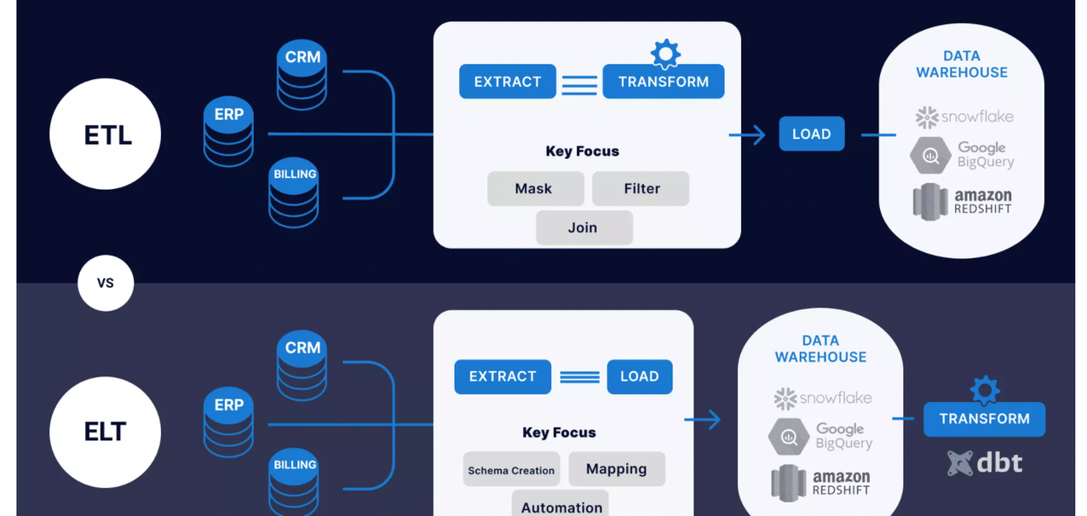
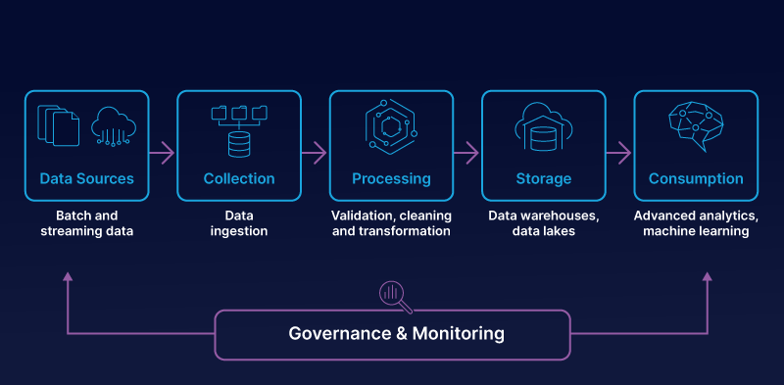
April 26th: Automating the Process
The goal is to automate the entire process, from web scraping to data analysis, and data modeling by creating pipelines.
Need Advice on how to prepare for this week.

Slide 10
Questions for class:
Creating Data Pipelines is a new concept to me. If anyone has experience with this, is there any recommendations or advice you want to give me?
Do you see any issues or is there any recommendation that you want to give me given everything I’ve mentioned?

